Slide 1

Playing with the Absurdity of welfare: Experiences of Irish cONDITIONALITY
Philip Finn
PhD Candidate,
Department of Sociology,
Maynooth University.
Email: philip.finn@mu.ie

Slide 2
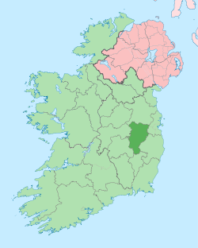

Methods
40 Qualitative Interviews
3 Cohorts: Jobseekers; Discouraged Jobseekers; Lone Parents
Kildare, East of Ireland (just outside of Dublin…)
Source: https://en.wikipedia.org/wiki/County_Kildare

Slide 3
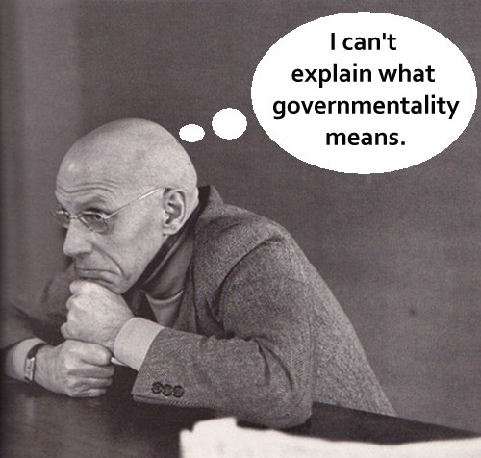
Foucault
Governmentality
Dominant Rationalities and Techniques of Practice
Top-down governance and subject formation
Not sufficient!
Source: https://adrianblau.wordpress.com/2013/06/07/when-foucault-says-eff-all-part-1/

Slide 4



Governmentality of unemployment in Ireland
Definitive policy trajectory aiming at life-long attachment to the labour market (Murphy 2016)
The death of unemployment and birth of jobseeking in Ireland (Boland and Griffin 2015)
“These strands will ensure that Ireland’s greatest resource, its people, will no longer remain on the Live Register for lengthy periods without an appropriate offer of assistance from the State. In return, individuals will be made aware of their responsibility to commit to job-search and/or other employment, education and training activities or risk losing welfare entitlements” (DEASP 2012).

Slide 5
The 8 techniques of irish welfare conditionality
Record of Mutual Commitments
Personal Progression Plan
Sanctions
  €44 reduction, suspended for 9 months, disqualification
Correspondence
Compulsory training courses
Provision of job-search evidence
‘Signing on’
  Weekly for payment
  Monthly, bi-monthly, tri-monthly ‘signing on’
Mandatory caseworker engagement
  Ongoing meetings, emails, phone-calls and text messages
  Online registration with, and submission of CV to, JobsIreland

Slide 6
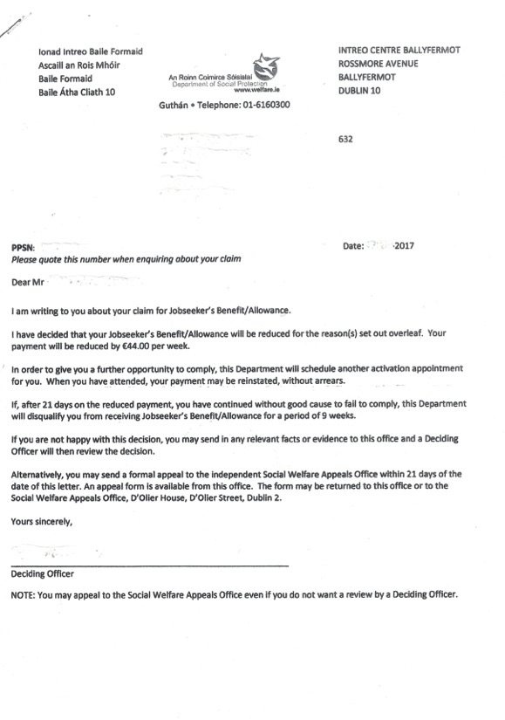
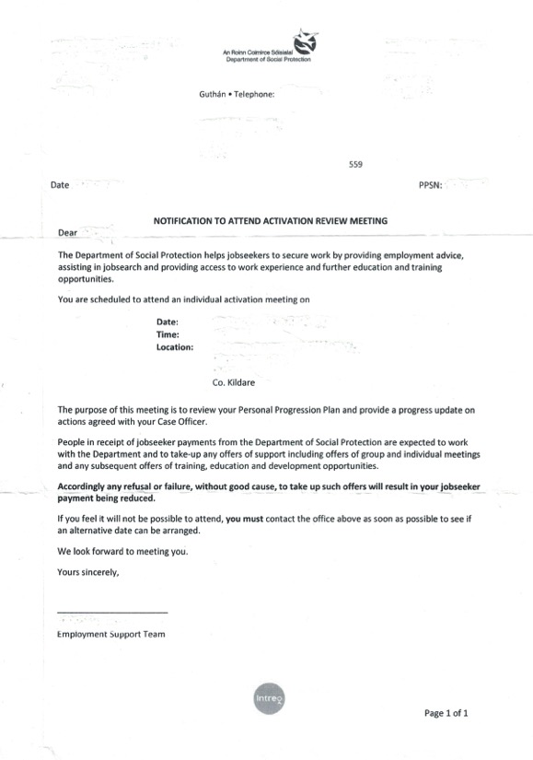

Slide 7
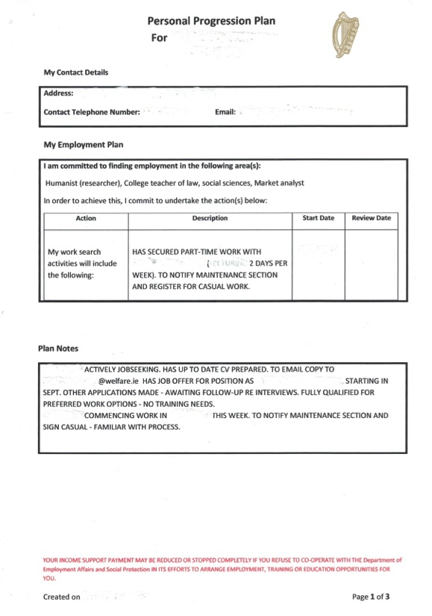

Slide 8
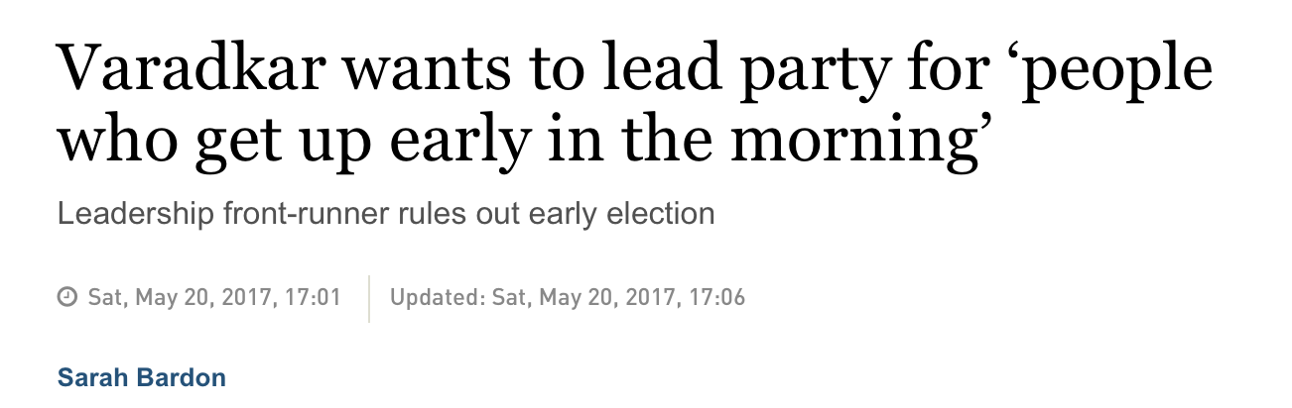
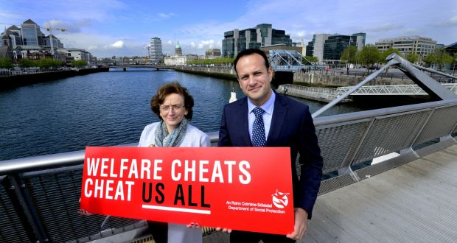
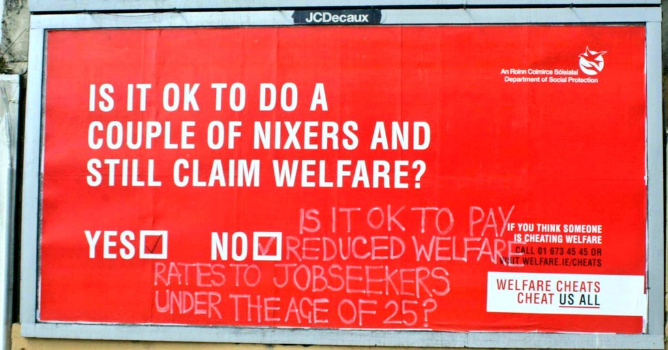
Master narrative and social construction of unemployment
“what we are getting at the moment is people who come into the system straight after school as a lifestyle choice” (Joan Burton quoted in Irish Independent 2011)
“young people should not be permanently in front of flat screen TVs” (Eamonn Gilmore quoted in Brennan 2013)

Slide 9
“I know it may not be popular to say this, but I think it does need to be said, all of this is paid for by taxpayers, who go out and work every day … they maybe aren't in their dream job, maybe aren't in a regular job but go out and work every day, earn money for their families and themselves and pay taxes … And they've a right to raise questions if somebody was saying: 'I'm not going to take a job because it's not suited to me or I don't like it, it's not the job I want. By the way, in the meantime you should pay for me'. We can't have that. That's not fair on the people who are working. That's not fair on taxpayers.”
- Leo Varadkar (Taoiseach)
“We cannot have a situation where you have people in the country who are serially and forever drawing social welfare benefits that other workers have to pay for through their taxes.”
- Enda Kenny (Former Taoiseach)

Slide 10
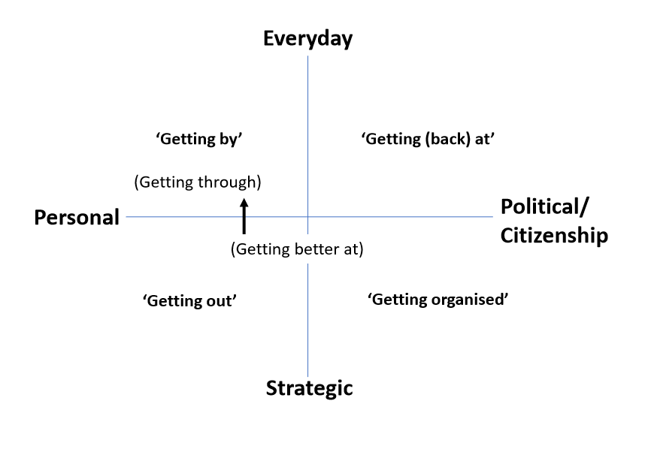
Ruth Lister’s Forms of agency
Street-level bureaucracy (Lipsky 1980; Brodkin 2013)
‘Everyday Resistance’ (Scott 1985; de Certeau 1984)
Refusals (Tronti 1966) and Lines of Flight (Deleuze 1995)

Slide 11
‘Getting By’
Managing material resources | Psychological coping
Budgeting Borrowing Household and Family | Stigma (Claims; Personal; Sigmatisation Avoidance Othering and (some anti-othering)
“On the Monday I borrow off the brother and then come Friday I have to pay him back…so I’m getting money of my daughter again on the Thursday til the Friday” (Jessica, 52) | “… because people know the days that people collect their money they know why you’re going in there, you can’t always pretend to be buying a stamp like” (Lisa 29) “One welfare officer had the nerve to tell me that I got myself pregnant …” (Nadine 47)

Slide 12
‘Getting Out’
Employment strategies | Educational Strategies | Payment Switching
Formal Informal / Undeclared Exhausted Jobsearching | Education Upskilling Meritocracy | Disability Allowance (permanent) Illness Benefit (temporary 1-2 years)
“I got really really desperate to just get away from them…just apply to any bit of shitty cleaning job” (Nadine, 47) “I need to keep money coming in irrespective of where it’s coming from… where I currently am taking cash for work I will be legitimate within 18 months” (Bob, 49) | “I’m going on ta college, it’s life…the state in this country have a lot to do…until they give me a council house.. I will be in education and if it takes 10 year then I’ll have a fucking PhD in Social Care” (Peter, 30) | Danny [caseworker] rung me up yesterday and … said [he] got a big list of people, he said, “your name was on it’, well I’m going to the doctor on Monday to see if I can get this applied for and he said “what I’ll do, I’ll hang on before I'll send anything back or close anything” … Colin

Slide 13
‘Getting (back) at’
Tactical mimicry | Fraud/ Unreported work | Covert vindictiveness
Going through the motions Impression management Course – ‘the least worst option’ | Undeclared Working | - Breaking out of tactical mimicry
“I applied for a job as a beauty consultant … an eyebrow threader … I’ve no idea what that is actually” (Nick, 57). | “One of the boys said to me there was a bit of painting in Dublin, I was in his Jeep every fucking morning for a week… Do I regret it? No I don’t, because Bertie and Enda and all the boys with their whip around at the Manchester United matches getting two and three hundred grand” (Peter, 30) | “they used to shove people in where it doesn't work, target driven and I can't, I can't wait to walk away from it. "Good luck and fuck yous. Leave me alone” … I'm walking in Friday there and I'm just going, "Up yours!“’ (Eamonn, 42)

Slide 14
‘getting organised’
Collective self-help | Collective resistance
Mental Health Organisation Mens’ Shed | Lack of Collective (Unemployed) Resistance Collective Resistance Elsewhere (Abortion Rights, Water Charges, Lone Parents)
“I was involved in the men’s shed … that’s what kept me going cos there’s lads up there you can talk to. I was talking to people.” (Simon, 47) | “We went up to every march there was… I wasn’t involved in the local group here no and that was the time I had the two jobs so it was very selective with what I could do…give out a few leaflets” (Kathi, 29)

Slide 15
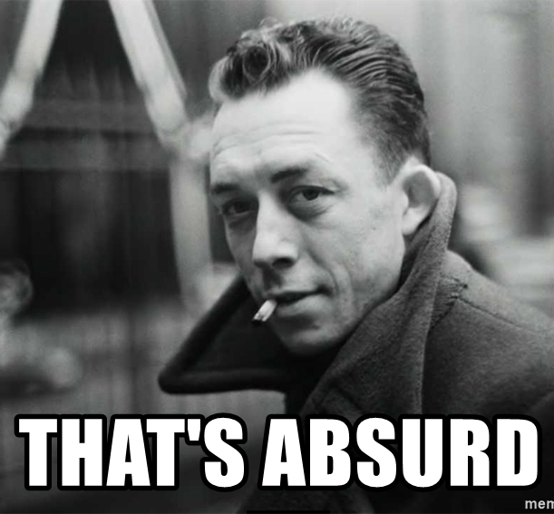
Irish Welfare services
Bureaucratic concerns with formalities rather than genuine engagement
  System marked by indifference rather than penalty
  But this indifference hurts
Unbearable lightness of conditionality?
Superficiality produces an encounter with the Absurd
  Frustrated and wasted agency

Slide 16
The Master Narrative of wORK
Redundancy of Conditionality
Enduring power of the work ethic
Macro-level governmental power
The positives of unemployment?
Not an innately negative experience
Social Reproduction
Liberation from paid employment is not liberation from work

